Slide 1
TQM
TQM FRAMEWORK
Definition of Quality, Dimensions of quality, Obstacles in implementing TQM, Benefits of TQM.

Slide 2
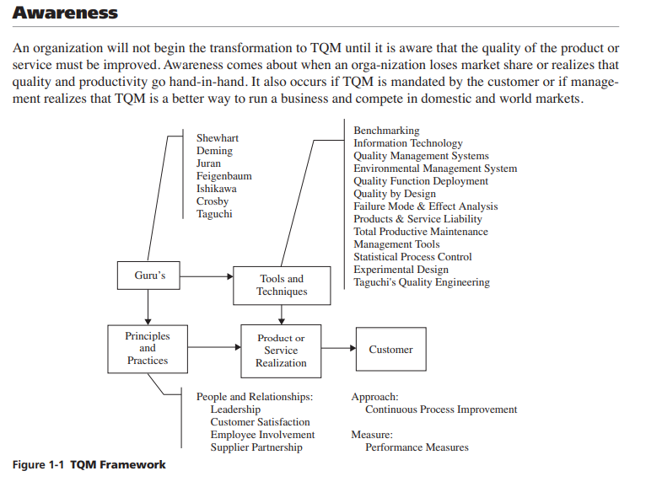
TQM FRAMEWORK

Slide 3
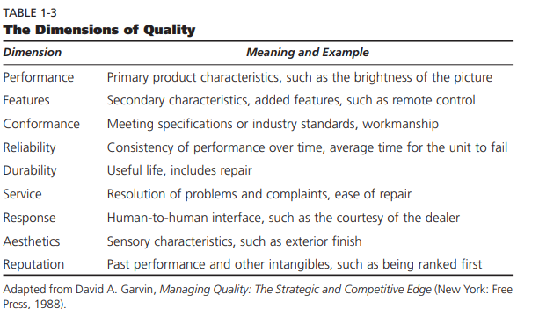
Defining Quality

Slide 4
Defining Quality
Definition of quality is dependent on the people defining it
There is no single, universal definition of quality
5 common definitions include:
(See next slide)

Slide 5
Defining Quality – 5 Ways
Conformance to specifications
Does product/service meet targets and tolerances defined by designers?
Fitness for use
Evaluates performance for intended use
Value for price paid
Evaluation of usefulness vs. price paid
Support services
Quality of support after sale
Psychological
Ambiance, prestige, friendly staff

Slide 6
Manufacturing Quality vs. Service Quality
Manufacturing quality focuses on tangible product features
Conformance, performance, reliability, features
Service organizations produce intangible products that must be experienced
Quality often defined by perceptional factors like courtesy, friendliness, promptness, waiting time, consistency

Slide 7
Cost of Quality
Quality affects all aspects of the organization
Quality has dramatic cost implications of:
Quality control costs
Prevention costs
Appraisal costs
Quality failure costs
Internal failure costs
External failure costs

Slide 8
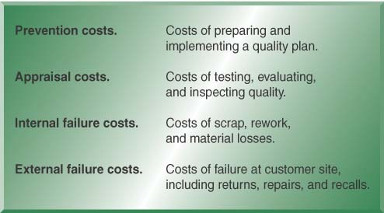
Cost of Quality – 4 Categories
Early detection/prevention is less costly
(Maybe by a factor of 10)

Slide 9
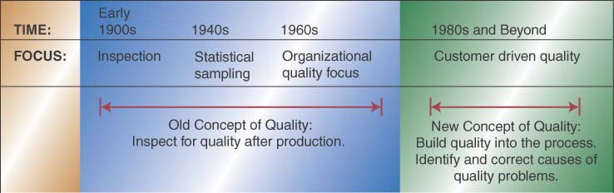
Evolution of TQM – New Focus

Slide 10
TQM Philosophy
TQM Focuses on identifying quality problem root causes
Encompasses the entire organization
Involves the technical as well as people
Relies on seven basic concepts of
Customer focus
Continuous improvement
Employee empowerment
Use of quality tools
Product design
Process management
Managing supplier quality

Slide 11
TQM Philosophy - concepts
Focus on Customer
Identify and meet customer needs
Stay tuned to changing needs, e.g. fashion styles
Continuous Improvement
Continuous learning and problem solving, e.g. Kaizen, 6 sigma
Plan-D-Study-Act (PDSA)
Benchmarking
Employee Empowerment
Empower all employees; external and internal customers

Slide 12
TQM Philosophy– Concepts con’t
Team Approach
Teams formed around processes – 8 to 10 people
Meet weekly to analyze and solve problems
Use of Quality Tools
Ongoing training on analysis, assessment, and correction, & implementation tools
Studying practices at “best in class” companies

Slide 13
Ways of Improving Quality
Plan-Do-Study-Act Cycle (PDSA)
Also called the Deming Wheel after originator
Circular, never ending problem solving process
Seven Tools of Quality Control
Tools typically taught to problem solving teams
Quality Function Deployment
Used to translate customer preferences to design

Slide 14
PDSA Details
Plan
Evaluate current process
Collect procedures, data, identify problems
Develop an improvement plan, performance objectives
Do
Implement the plan – trial basis
Study
Collect data and evaluate against objectives
Act
Communicate the results from trial
If successful, implement new process

Slide 15
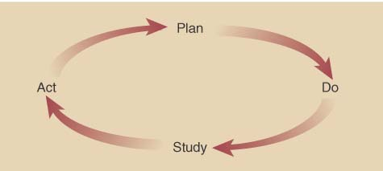
PDSA con’t
Cycle is repeated
After act phase, start planning and repeat process

Slide 16
TQM Within OM
TQM is broad sweeping organizational change
TQM impacts
Marketing – providing key inputs of customer information
Finance – evaluating and monitoring financial impact
Accounting – provides exact costing
Engineering – translate customer requirements into specific engineering terms
Purchasing – acquiring materials to support product development
Human Resources – hire employees with skills necessary
Information systems – increased need for accessible information

Slide 17
“Costs” of Quality
Category | Definition | Example
Prevention | Costs associated with preventing defects. | Training, early reviews, quality planning, tools, process improvement initiatives.
Appraisal | Costs associated with analyzing and testing the product to ensure it conforms to specifications. | Inspections, testing, audits, quality control.
Internal Failure | Costs associated with fixing defects found prior to release. | Repair, retesting, updating documentation.
External Failure | Costs associated with fixing defects found after release. | Technical support, defect reporting and tracking, field updates, loss of future sales.

Slide 18
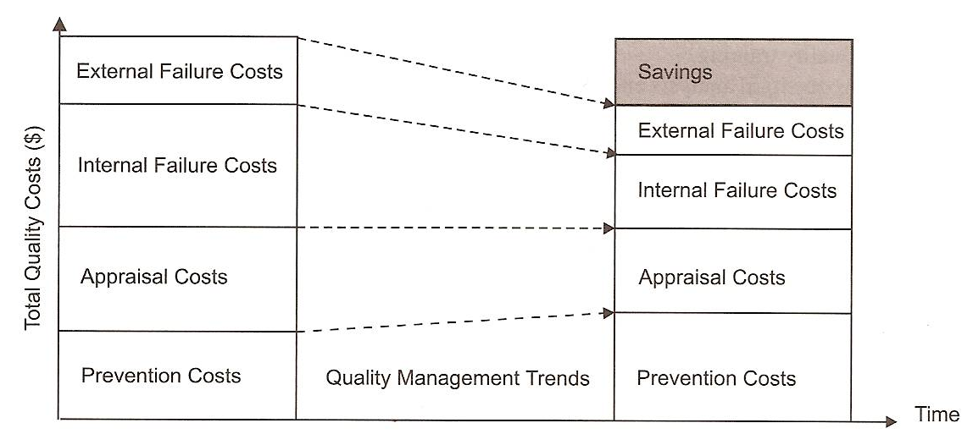
“Costs” of Quality
Quality Cost Management shows how increased Prevention Costs reduce the Total Quality Costs.

Slide 19
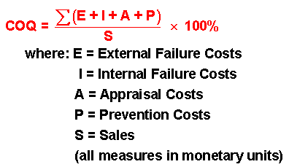
“Costs” of Quality
The equation “Cost of Quality“ (COQ) allows to quantify the impact of POOR quality. It is used as a monitoring tool to track costs for inspection, internal errors, external errors, and prevention. As the prevention efforts are increased, the costs for inspection, internal failures and external failures drop.
E: External Failure Costs
I: Internal Failure Costs
A: Appraisal Costs
P: Prevention Costs
S: Sales

